Slide 1
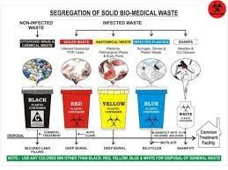

Management of Domestic and Medical hazardous waste

Slide 2
Objectives
What is Hazardous Waste
Waste Disposal Options
Waste Collection Models
Hazardous Waste Generator Status
What is hospital Waste
Proposed Management Standards for Hazardous medical Waste

Slide 3
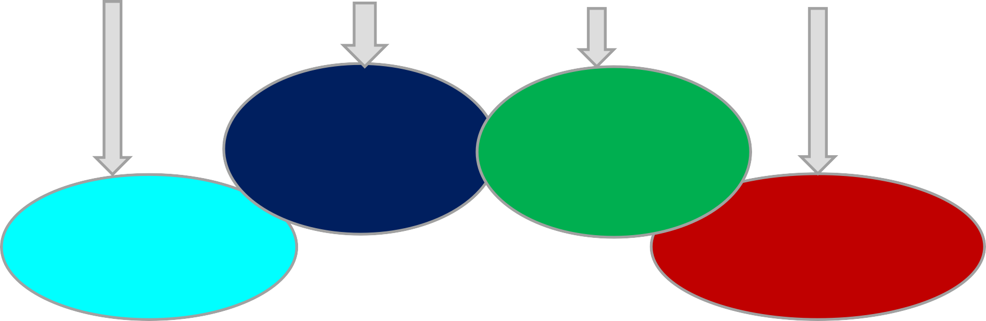
Factors lead to increase the amount and the variety of solid wastes generated by industrial, domestic and other activities.
World’s population
Standards
of living
Technology developments
Urbanization
In developing countries, the problems of dealing with greater volumes of materials are particularly is acute, why?
Because these changes have not been met by improvements in
waste management technologies

Slide 4
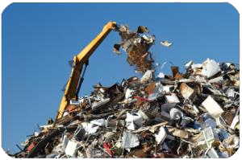
WHAT IS WASTE/DOMESTIC WASTE:
Wastes are unwanted material discarded after primary use.
Domestic waste:
includes that from domestic premises, residential homes, educational establishments (schools, universities), nursing homes and hospitals.

Slide 5
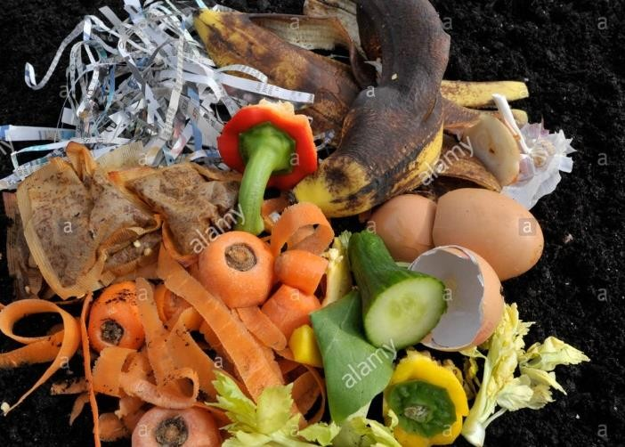
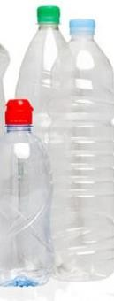
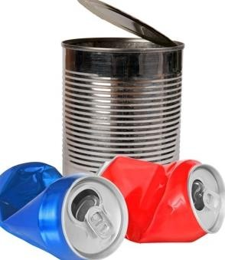
Types of DOMESTIC WASTE
organic
non-organic
Tin cans
Plastics and bottles
Organic waste can decay
e.g. food.

Slide 6
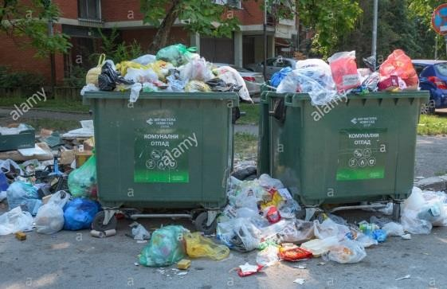
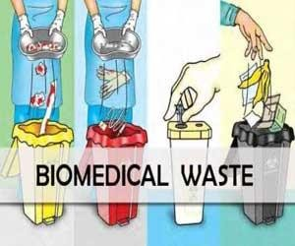
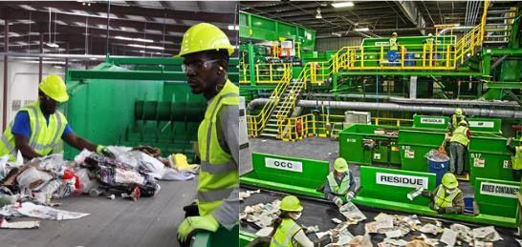
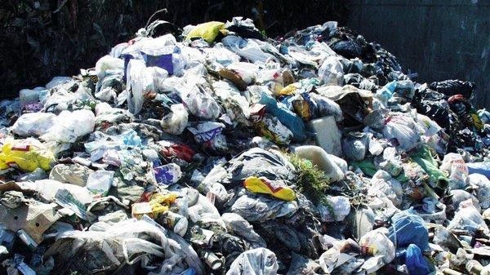
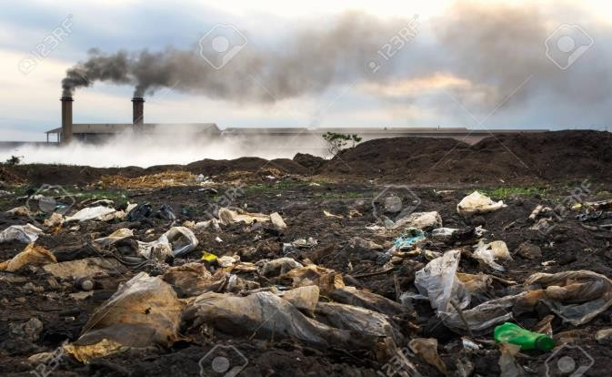
Classification of solid wastes
according to their source of origin
Municipal waste
Industrial waste
Biomedical /hospital

Slide 7
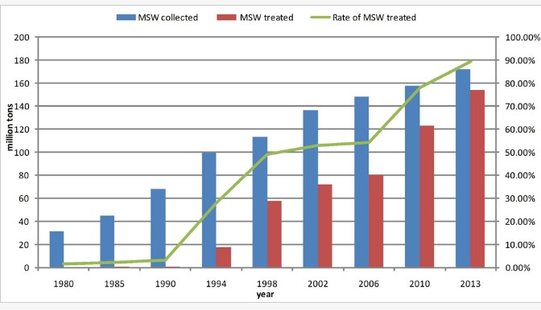
Magnitude of waste products
Municipal solid waste (MSW) management in China from 1980 to 2013

Slide 8
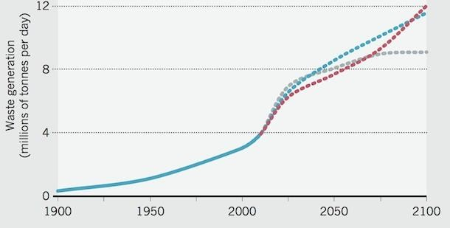
Past and Projected global waste generation
Global waste generation in 2100 is
estimated to be 2.9 times that in 2010.

Slide 9
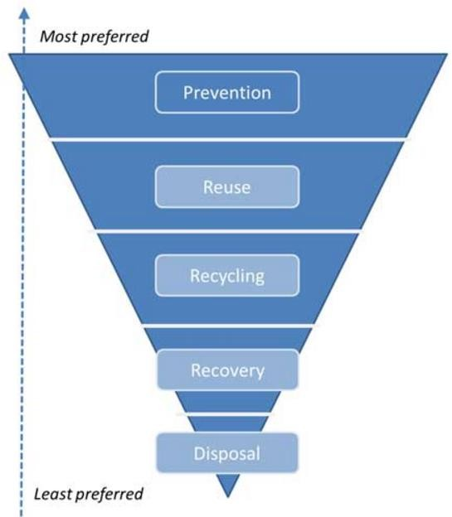
Waste management hierarchy (UNEP, 2011).
preventing waste through efficient use of resources and raw materials is the best option.
Re-using discarded goods
without reprocessing or remanufacture is assumed to provide greater savings in resource consumption.
Prevention
Reuse
Recycling
Recovery
Disposal

Slide 10
Ways to reduce waste that enters waste stream
Recovery (recycling, composting) = next best strategy in waste management
  Recycling = sends used goods to manufacture new goods
  Composting = recovery of organic waste
Minimizing the amount of waste we generate (source reduction)
Recovering waste materials and finding ways to recycle them
Disposing of waste safely and effectively
10

Slide 11
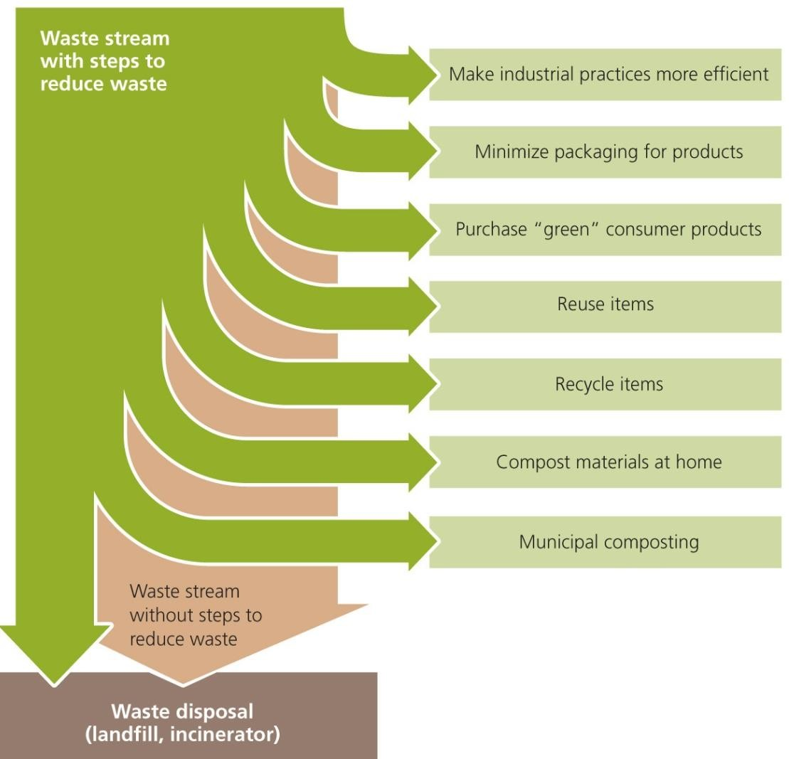
We have several aims in managing waste
11

Slide 12

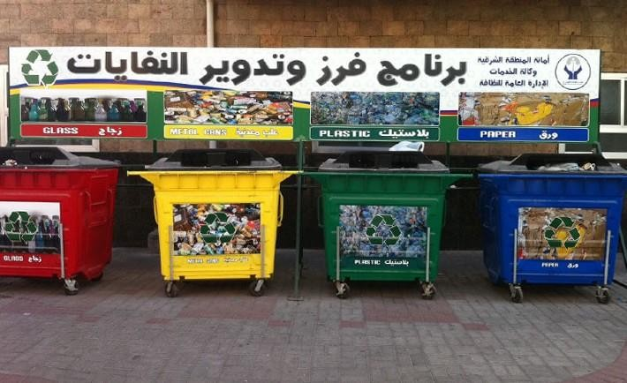

Slide 13
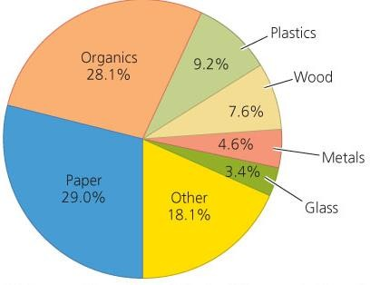
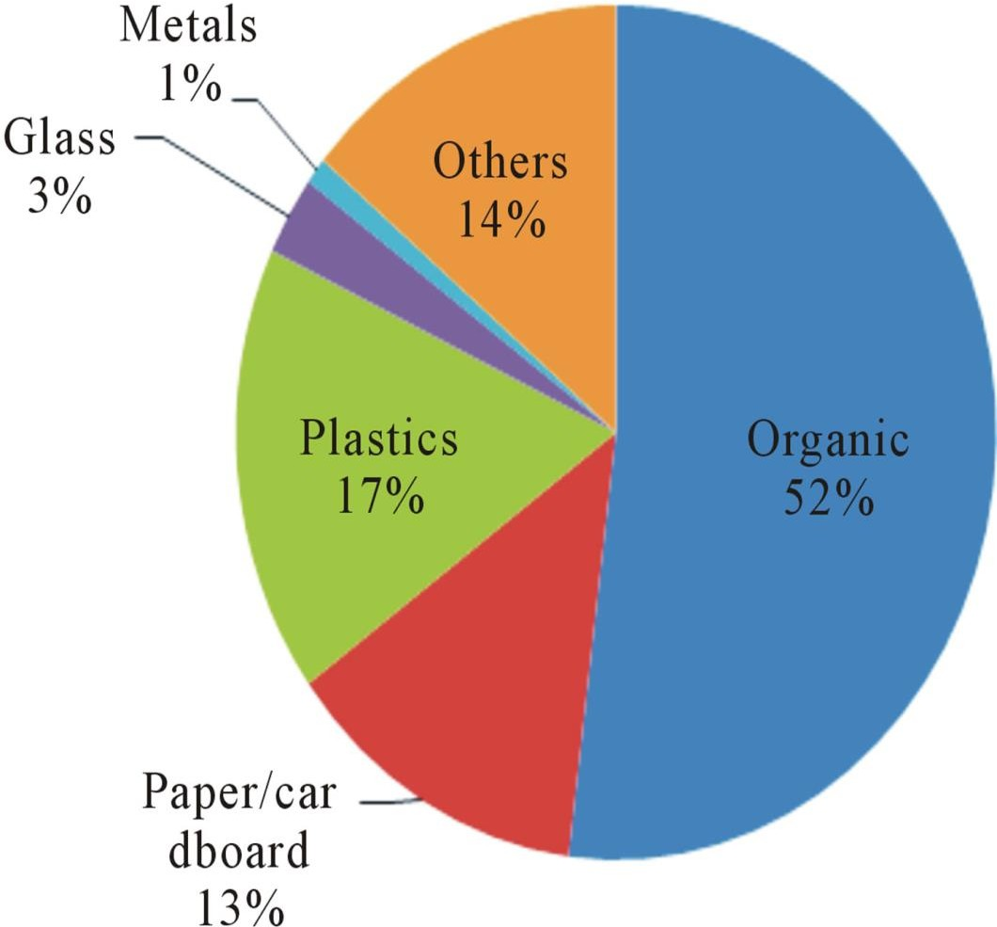
Recyclable and compostable materials in municipal solid waste
Recyclable and compostable materials in Canada
Global trend of recyclable and compostable materials in
13

Slide 14
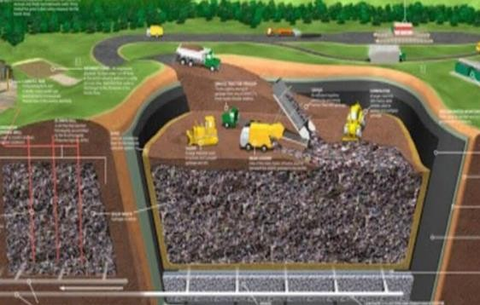
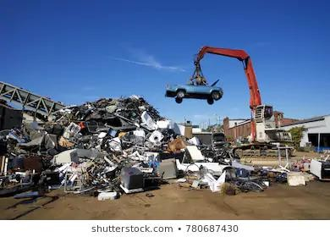
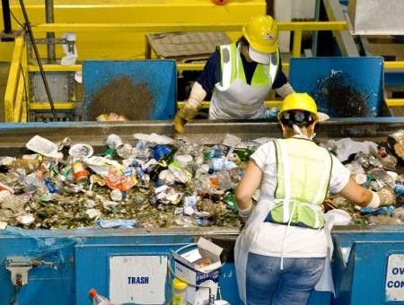
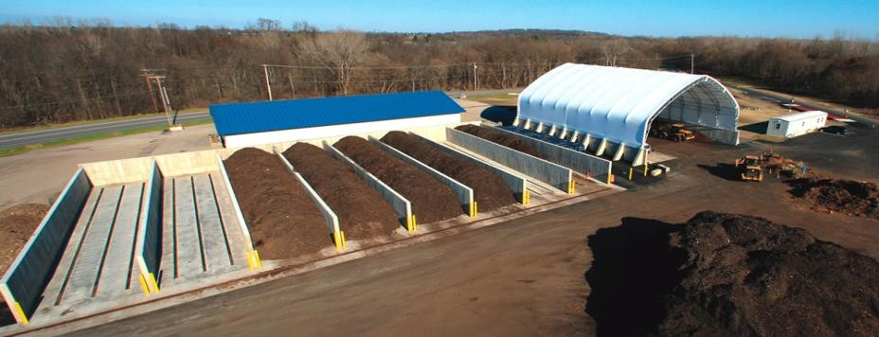
Waste storage, treatment and disposal sites
controlled as sanitary landfill
uncontrolled as open dumps
Landfills
scrap-yards;
waste collection and processing facilities
composting facilities.

Slide 15
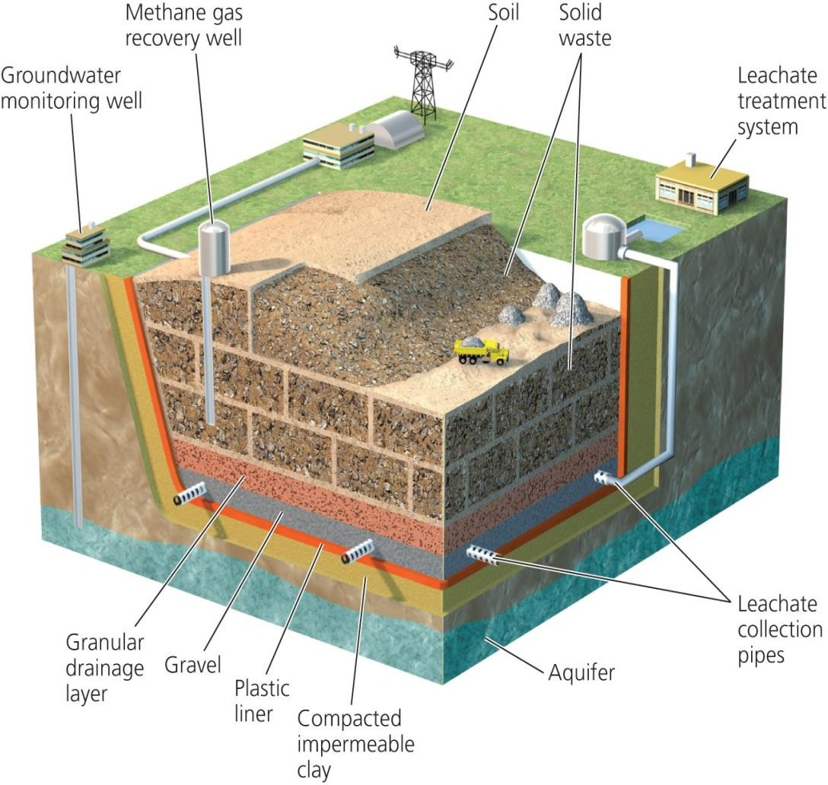
Sanitary landfills are engineered to minimize leakage of contaminants
Sanitary landfills = waste buried in the ground or piled in large, engineered mounds
15

Slide 16
Landfills can produce gas for energy
Bacteria can decompose waste in an oxygen- deficient environment
Landfill gas = a mix of gases that consists of roughly half methane
  Can be collected, processed, and used like natural gas
  When not used commercially, landfill gas is burned off in flares to reduce odors and greenhouse emissions
More than 40 operational projects in Canada collect landfill gas and convert it into energy
16

Slide 17
Incinerating trash reduces pressure on landfills
Incineration = a controlled process in which mixed garbage is burned at very high temperatures
Incineration in specially constructed faculties can be an improvement over open-air burning of trash
  But, the remaining ash must be disposed of in a hazardous waste landfill
  Hazardous chemicals are created and released during burning
Scrubbers = chemically treat the gases produced in combustion to remove hazardous components and neutralize acidic gases
17

Slide 18
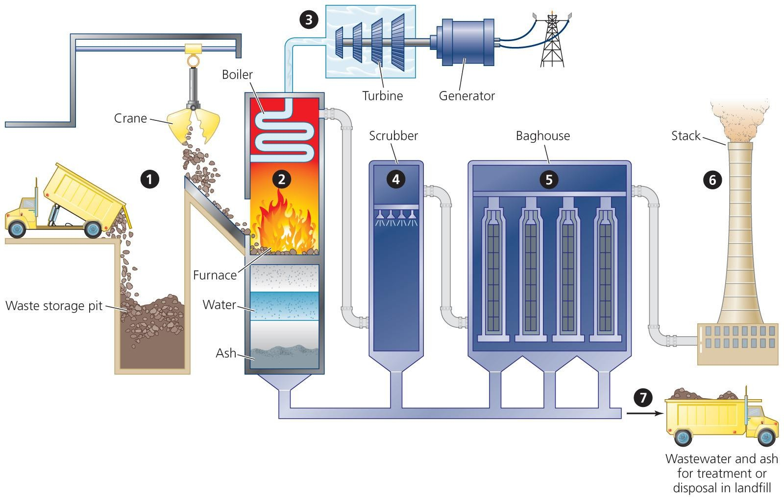
Incinerators reduce the volume of solid waste but may emit toxic compounds into the air
18

Slide 19

Recycling consists of three steps
1
Collection and processing of recyclable materials by municipalities and businesses
3
Consumer purchase of products made from recycled materials
2
Use of recyclables by industry to manufacture new products
19

Slide 20
Current situation in municipal waste management in Saudi Arabia
The high rate of population growth, urbanization and economic expansion in Saudi Arabia (KSA
top-ten countries
worldwide in terms of per capita waste generation.
is leading to increased and accelerating rates in municipal solid waste generation
Solid waste management, especially in the largest cities – Riyadh, Jeddah and Dammam, is becoming a big challenge for the government and local bodies.

Slide 21
THE SITUATION IN RIYADH CITY
The amount of municipal solid waste generated in Riyadh city is 10,228/tons/day.
An average waste generated daily by individual is 1.5 Kg compared to 0.5 kg in developed countries.
Six thousand tons of household and commercial waste is transported per day in addition to 4000 tons as construction waste.
 | Average daily waste produced for the city of Riyadh
Region |  | Aluraija | Shumaisi | Roudha and Northen Regions | Naseem And Sulay | Aziziyah | Olaya | AlMalaz And Batha | Almather | Total
Waste (tons/day) |  | 680 | 787 | 1410 | 1706 | 1415 | 1090 | 2477 | 663 | 10228

Slide 22
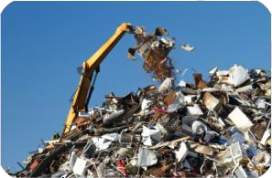
Saudi Government Initiatives and policies practices
Due to the critical demand for waste management, the country invested heavily to solve this problem through:
improve recycling and waste disposal activities.
Strong legislations,
financial support,
public awareness,
modern technologies and
stakeholders’ participation

Slide 23
Medical Waste Management Program

Slide 24
Health-care waste
Definition
Health-care waste (Medical waste) includes all the waste generated by health-care establishments, research facilities, and laboratories.
In addition, it includes the waste originating from minor or scattered sources, such as that produced in the course of health care undertaken in the home (dialysis, insulin injections, etc.)

Slide 25
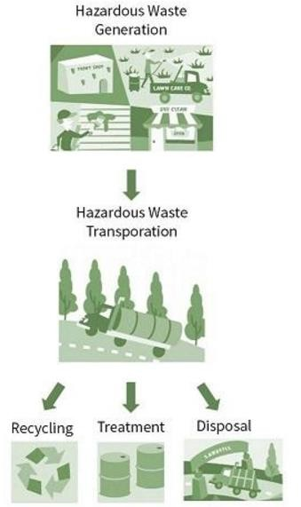
Hazardous Materials & Medical Waste Management
Of the total amount of waste generated by health-care activities, about 85% is general, non- hazardous waste.
The remaining 15% is considered hazardous material that may be infectious, toxic or radioactive.

Slide 26
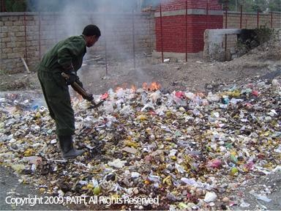
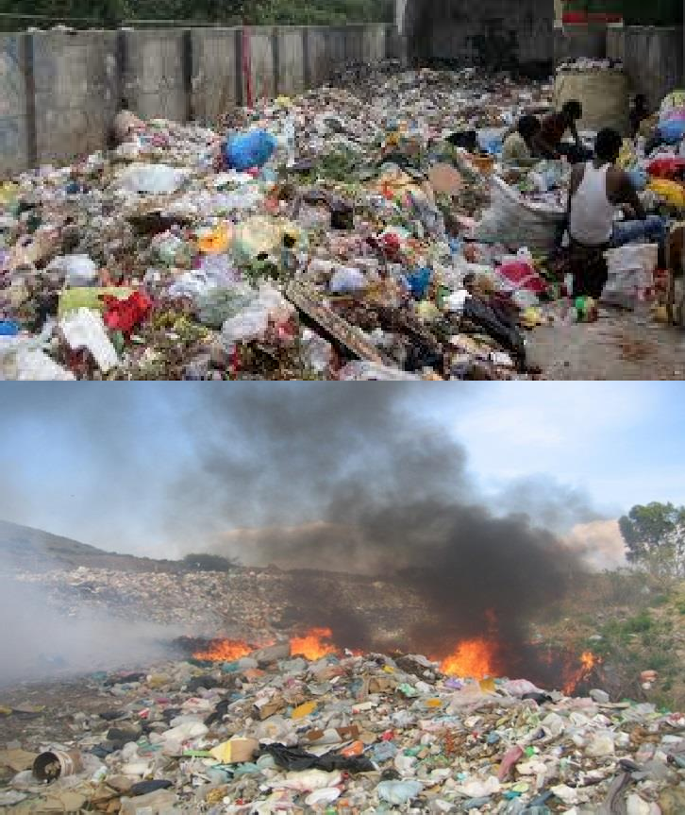
Magnitude of Health-care waste
Every year an estimated 16 billion injections are administered worldwide, but not all of the needles and syringes are properly disposed of afterwards.
Health-care waste contains potentially harmful microorganisms, which can infect hospital patients, health workers and the general public.
Health-care waste in some circumstances is incinerated, and dioxins and other toxic air pollutants may be produced as emissions.

Slide 27
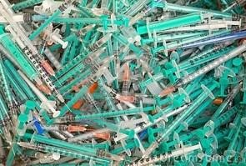
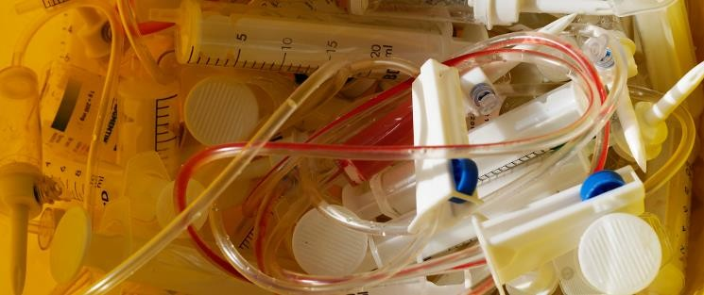
What composed Medical Waste?
Any Partially Used or Unused Medication Including:
  Syringes
  Vials, Bottles
  IV Bags and Tubing With Medicine Additives
  Loose Pills, Tablets, Capsules
  Aerosol Inhalers
  Creams, Ointments, Shampoos
  Patient Prep-Alcohol and Iodine
Empty Vials/Containers That Held P-Listed Drugs
  Nicotine, Warfarin, etc.

Slide 28
What composed Medical Waste?
Infectious waste:
  waste contaminated with blood and other bodily fluids,
  cultures from laboratory work,
  waste from patients with infections (swabs, bandages)
Pathological waste:
  human tissues,
  organs or fluids,
  body parts
Sharps waste: syringes, needles, disposable scalpels and blades, etc.;

Slide 29
What composed Medical Waste?
Chemical waste: solvents and reagents, disinfectants, heavy metals in medical devices
Pharmaceutical waste: expired, unused and contaminated drugs and vaccines;
Cytotoxic waste: genotoxic properties, carcinogenic.
Radioactive waste: radionuclides, radioactive diagnostic material
Non-hazardous or general waste: waste that does not pose any particular biological, chemical, radioactive or physical hazard.

Slide 30
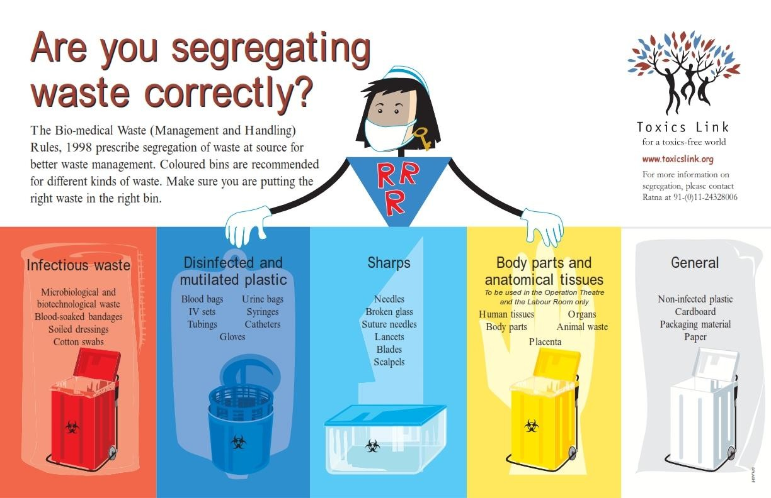
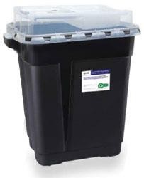
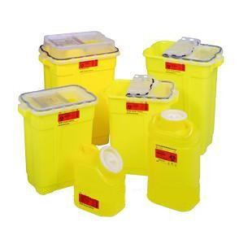
Health-care waste

Slide 31
Health-care waste generation
Health-care waste generation according to source size
hospitals and other health facilities
laboratories and research centres
mortuary and autopsy centres
animal research and testing laboratories
blood banks and collection services
nursing homes for the elderly

Slide 32
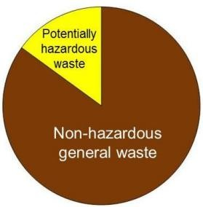
General Types of Healthcare Waste
Healthcare waste can be
Non-hazardous general wastes comparable to domestic waste (75-90% of healthcare waste in a health facility)
Potentially hazardous waste or waste that is associated with some health risks (10-25% of healthcare waste in a health facility)

Slide 33
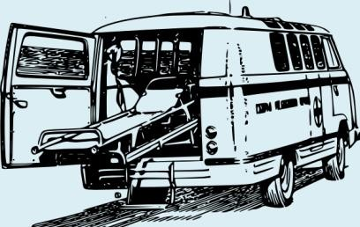
Sources of Healthcare Waste
Hospitals
Clinics
Laboratories
Research activities
Nursing homes
Acupuncturist
Paramedic and ambulance services
Animal research
Blood banks Mortuaries
Autopsy centers

Slide 34

Other Sources of Healthcare Wastes
Physicians’ offices
Dental clinics
Chiropractors
Psychiatric hospitals
Cosmetic piercing and tattooing
Institutions for disabled persons
Funeral services
Home healthcare

Slide 35
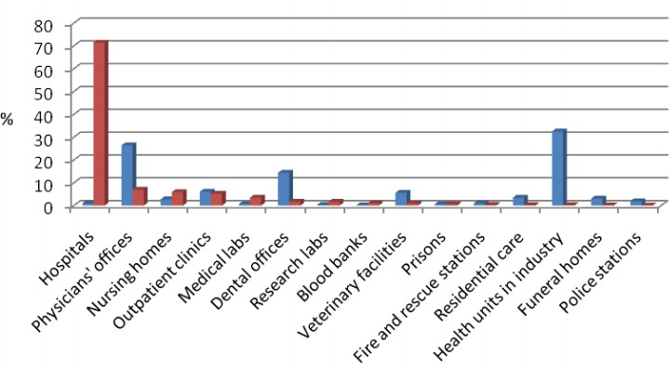
Which Institutions Generate the Most Amount of Healthcare Waste?
% of the total annual healthcare waste generated
% of the total number of facilities

Slide 36
General Characteristics of Healthcare Waste
Total waste generated in hospitals:
2 - 4 kg per bed per day
Infectious waste generated in hospitals with good segregation:
0.2 - 0.4 kg per bed per day
Average bulk density of healthcare waste:
About 100 - 200 kg per cubic meter

Slide 37
Health Risk and impacts of health-care waste
Hazards of health-care waste
Types of hazards: disease or injury (it contains infectious agents; genotoxic; contains sharps)
Persons at risk: medical doctors, nurses, health-care auxiliaries, and hospital maintenance
Personnel, patients in health-care establishments, visitors, workers..etc)
Hazards from infectious waste and sharps: pathogenic microorganisms (through a puncture, abrasion, or cut in the skin)

Slide 38
Health impacts of health-care waste
Hazards from chemical and pharmaceutical waste: (e.g. toxic, genotoxic, corrosive, flammable, explosive, shock-sensitive)
Hazards from genotoxic waste: (the substance toxicity itself and the extent and duration of exposure.). pathways of exposure are inhalation of dust or aerosols, absorption through the skin, ingestion
Hazards from radioactive waste (genotoxic, it may also affect genetic material.)
Public sensitivity: about the visual impact of anatomical waste, that is recognizable human body parts.

Slide 39
Health and safety practices for health-care personnel and waste workers
Workers protection
The production, segregation, transportation, treatment, and disposal of health-care waste involve the handling of potentially hazardous material.
Protection against personal injury is therefore essential for all workers who are at risk.

Slide 40
Protective clothing
The type of protective clothing used will depend to an extent upon the risk associated with the health-care waste, but the following should be made available to all personnel who collect or handle health-care waste:
  Helmets, with or without visors depending on the operation.
  Face masks depending on operation.
  Eye protectors (safety goggles) depending on operation.
  Overalls (coveralls) obligatory.
  Industrial aprons obligatory.
  Leg protectors and/or industrial boots obligatory.
  Disposable gloves (medical staff)

Slide 41
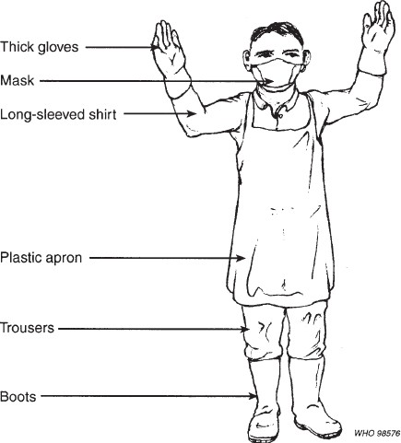
Recommended protective clothing for health-care waste transportation in small hospitals in Thailand

Slide 42
Training Requirements
Department of Transportation (DOT) Hazardous Materials Training – required for all employees who prepare hazardous materials for shipment, sign manifests, etc. (8 hours every 3 years)
OSHA Emergency Response Training (HAZWOPER) – required for all employees who have the potential to respond or initiate response to hazardous material spills, level of training and classroom time dependent on employee responsibilities (minimum 8 hours/year)
  EPA Hazardous Waste Generator Training (RCRA) – required for all employees who handle hazardous waste containers outside of satellite accumulation areas or who have responsibilities related to managing central waste storage areas (generally 8 hours/year)

Slide 43


Training
Meet with leadership from key departments
Nursing
Pharmacy
Imaging
Surgical Services
Medical Staff

Slide 44
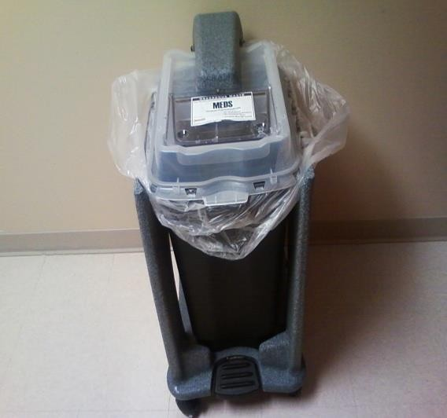
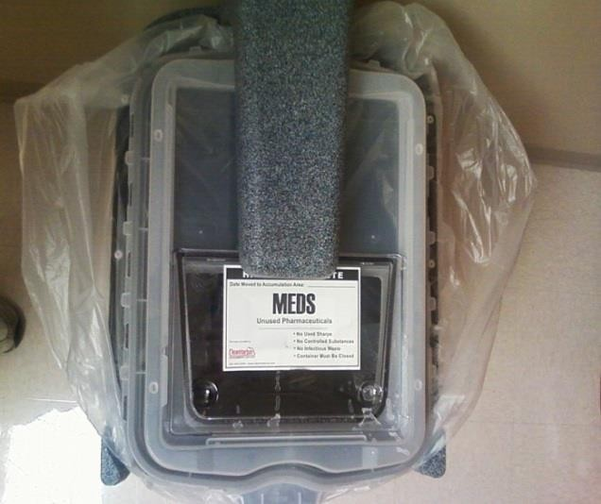
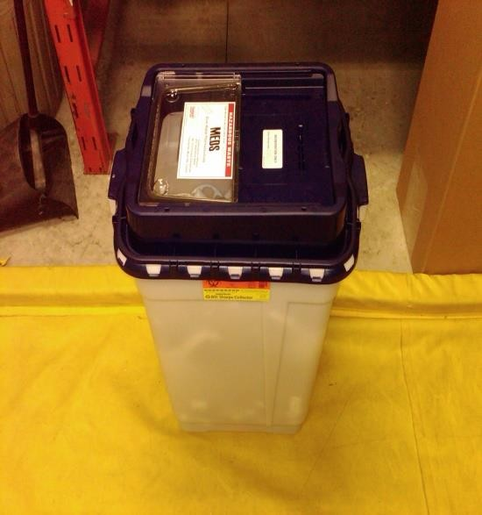
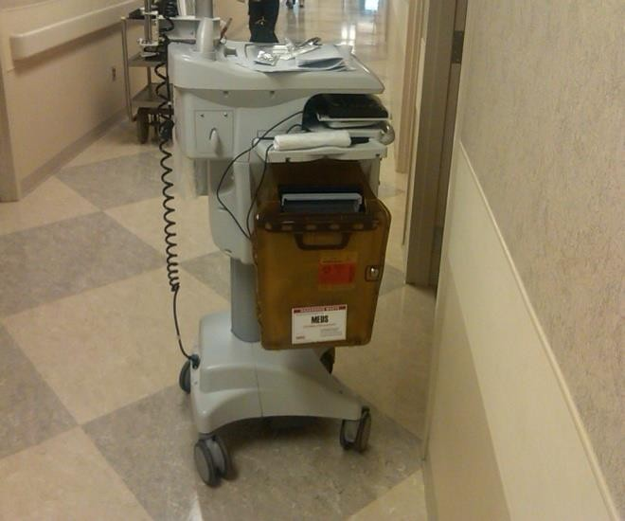
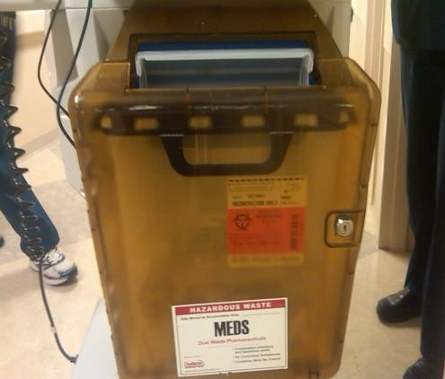
Pharmaceutical Waste Container Examples

Slide 45
EFFECTS OF WASTE IF NOT MANAGED WISELY
Affects our health
Affects our socio-economic conditions
Affects our coastal and marine environment
Affects our climate

Slide 46
Financial incentives can help address waste
Pay-as-you-throw = uses financial incentives to influence consumer behavior
– The less waste a house generates the less it is charged for trash collection
Return-for-refund = consumers pay a deposit, and receive a refund for returning used bottles
46

Slide 47
Conclusion
Modern methods of waste management are far safer for people and gentler on the environment
Recycling and composting are making rapid progress
Our prodigious consumption habits have created more waste than ever before
Finding ways to reduce, reuse and efficiently recycle the materials and goods that we use stands as a key challenge for this century
47

Slide 48

Questions?

